Slide 1




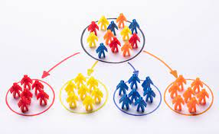
Prediction Model of Customer Relationship Management to Generate Customer Segmentation of Electric Service Users Using Machine Learning
Radit Rahmadhan
Supervised by:
Meditya Wasesa, S.T., M.Sc., Ph.D.

Slide 2


List of Contents
01
Introduction
02
Literature Review
03
Methodology
04
Expected Result

Slide 3
01
Introduction

Slide 4
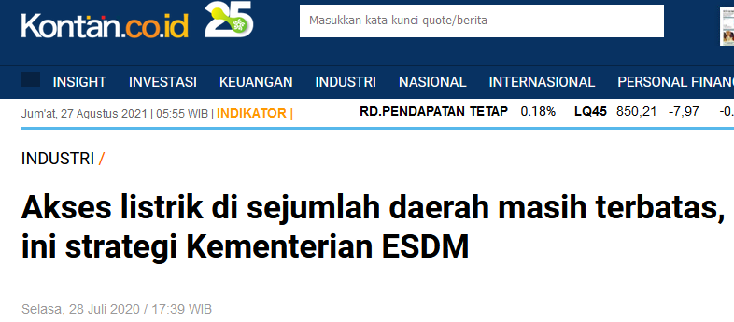
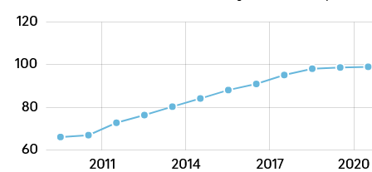
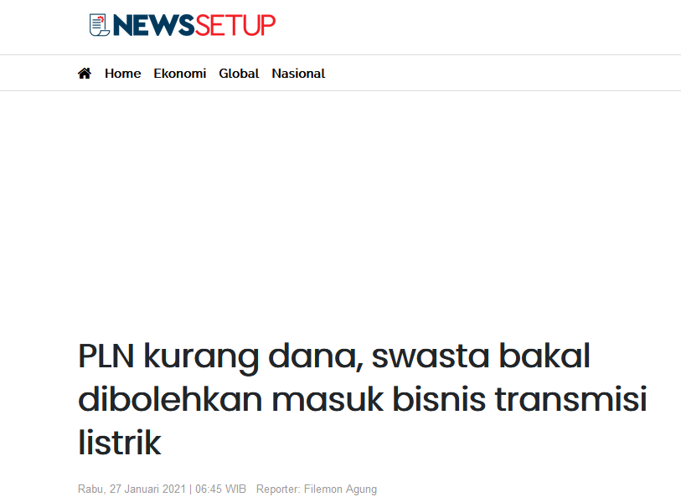
Background
Source : Katadata.co.id
99,53%
66,28%
The increasing number of electricity users in Indonesia from 2010 to 2020 is around 33.25%
Electricity providers to remote areas are still limited
The Indonesian government plans to open the door for the private sector to enter the electricity transmission business.
PLN needs to understand customer segmentation and customer preferences

Slide 5
Research Question & Objectives
Research Question :
How is the impact of using a combination of Customer Relationship Management and Key Account Marketing methods in measuring customer segmentation?
How effective is the implementation of Key Account Marketing in Customer Relationship Management?
Research Objectives :
To create a new framework by adding Key Account Marketing in predicting customer segmentation.
To increase the effectiveness or speed in predicting Customer Relationship Management by adding Key Account Marketing.

Slide 6
02
Literature Review

Slide 7
Machine Learning In The CRM Framework
Source : Payne 2012

Slide 8
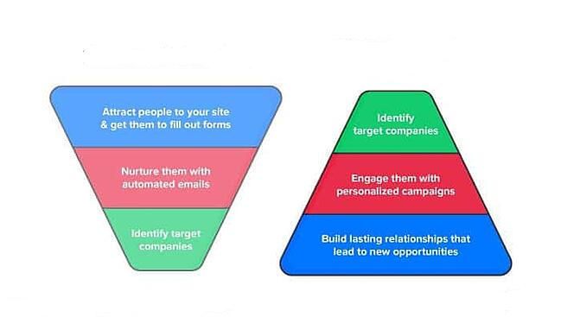
Improve with Key Account Marketing (KAM)
CRM
KAM
Source : Hult 2019

Slide 9
03
Methodology

Slide 10
Research Framework
Steps in analyzing
Prepare the data used
Building The Maining Data Set
Selecting The Segmentation
Processed With 3 Machine Learning
Find New Model

Slide 11
Expected Result
The suggested customer segmentation model can provide innovations to PLN
Predict new customers because in the future they want to make housing in untouched areas so they can prepare electricity supply.
Adding KAM can increase the effectiveness of CRM
Finding an effective model by comparing several machine learning models

Slide 12
The Process of Trying to Process the Model
Segment 1: Office and Industry Cluster K-Means : 25 % Naïve Bayes : 25% Linear Regression : 15% | Segment 2: Big Household and Business Cluster K-Means : 15 % Naïve Bayes : 25% Linear Regression : 30%
Segment 3 : Middle House Hold Cluster K-Means : 20 % Naïve Bayes : 25% Linear Regression : 25% | Segment 4 : Small House Hold Cluster K-Means :50 % Naïve Bayes : 25% Linear Regression : 40%

Slide 13
Thank You

